Slide 1

Common Problems in Greenhouse Crop Production
John Erwin
Department of Plant Science and Landscape Architecture
University of Maryland – College Park

Slide 2

Common Problems in Production
Deep planting
The right temperature
Premature of late flowering
CO₂ deficiency
Stretching and late pruning
pH and EC
PGR mistakes
Bad heaters
Pests and Diseases
What’s new?

Slide 3
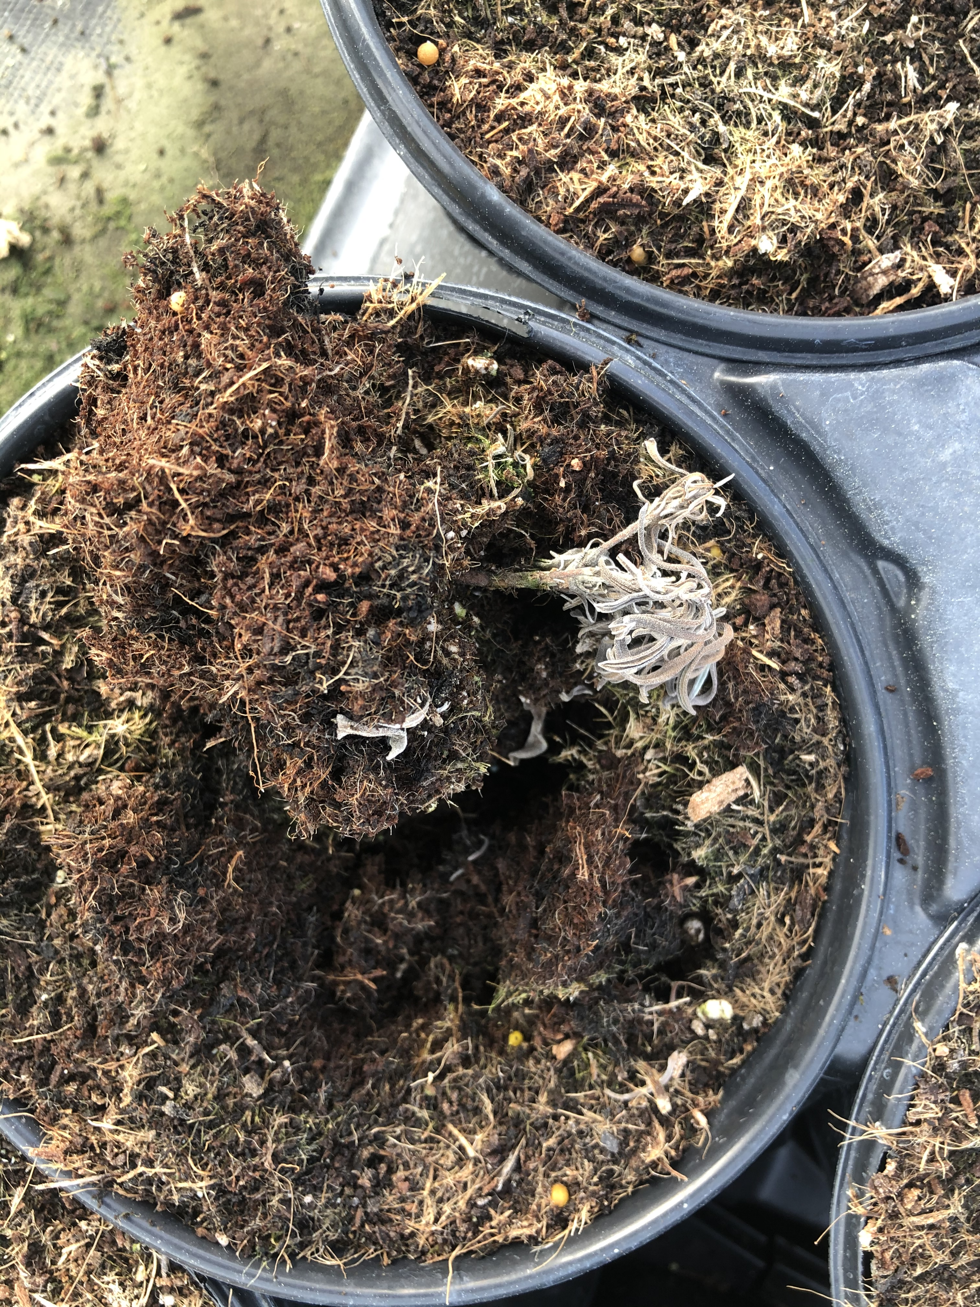

Slide 4
Take Home Message . . .
Deep planting increases the possibility of freshly planted liners/plugs getting Rhizoctonia or Fusarium.
If plants are banged around after planting and on their way to be laid down, reset plants while setting down.
If deep planting is a regular problem, definitely to a plug/liner drench (see later).
Do a liner drench of Subdue + Medallion prior to planting

Slide 5
Common Problems in Production
Deep planting
The right temperature
Premature of late flowering
CO₂ deficiency
Stretching and late pruning
pH and EC
PGR mistakes
Bad heaters
Pests and Diseases
What’s new?

Slide 6
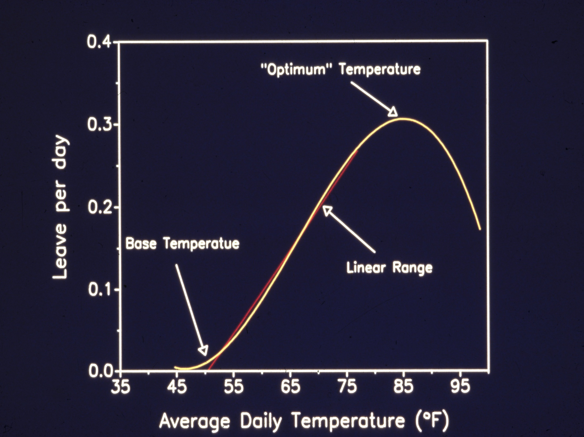

Slide 7
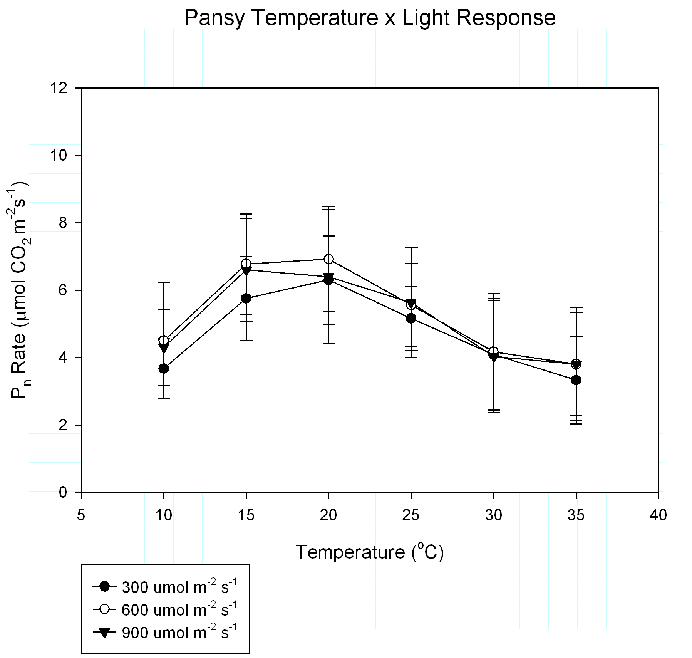

Slide 8
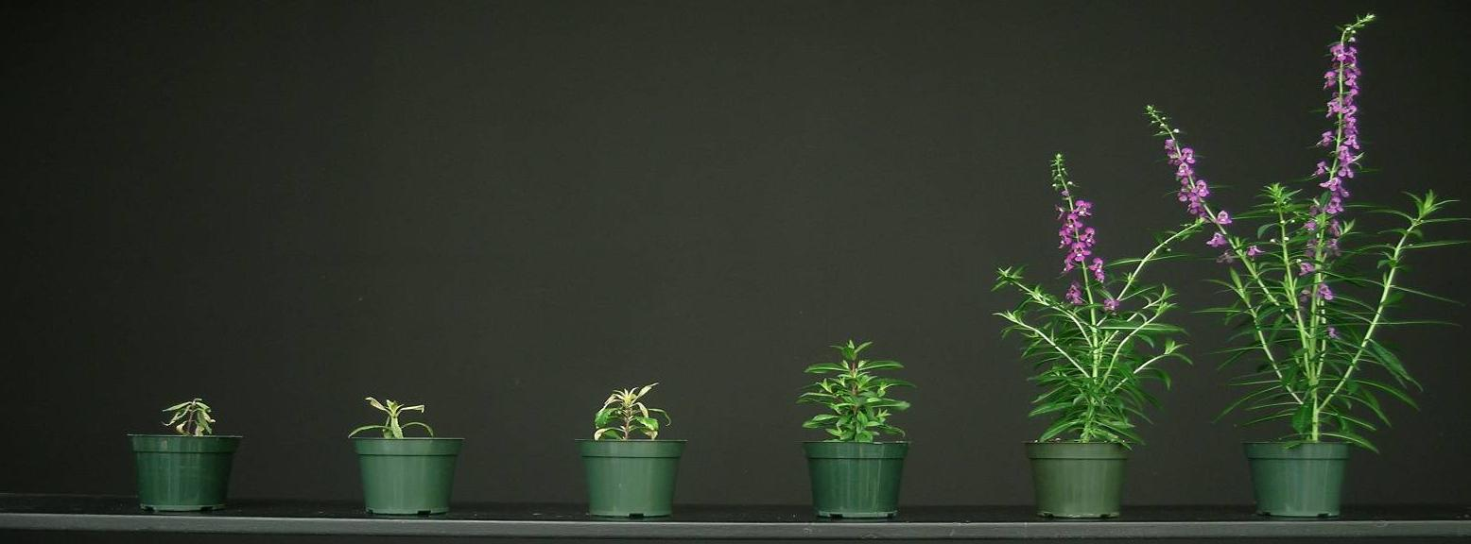
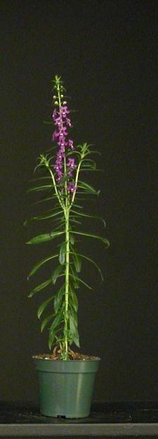
Angelonia ‘Serena Purple’
Days to flower at: °F
41
45
50
59
68
77
86
Average DLI: 10 mol∙m⁻²∙d⁻¹
Dead
Dead
No flower
62
36
27
27
Matthew Blanchard, Michigan State Univ.

Slide 9
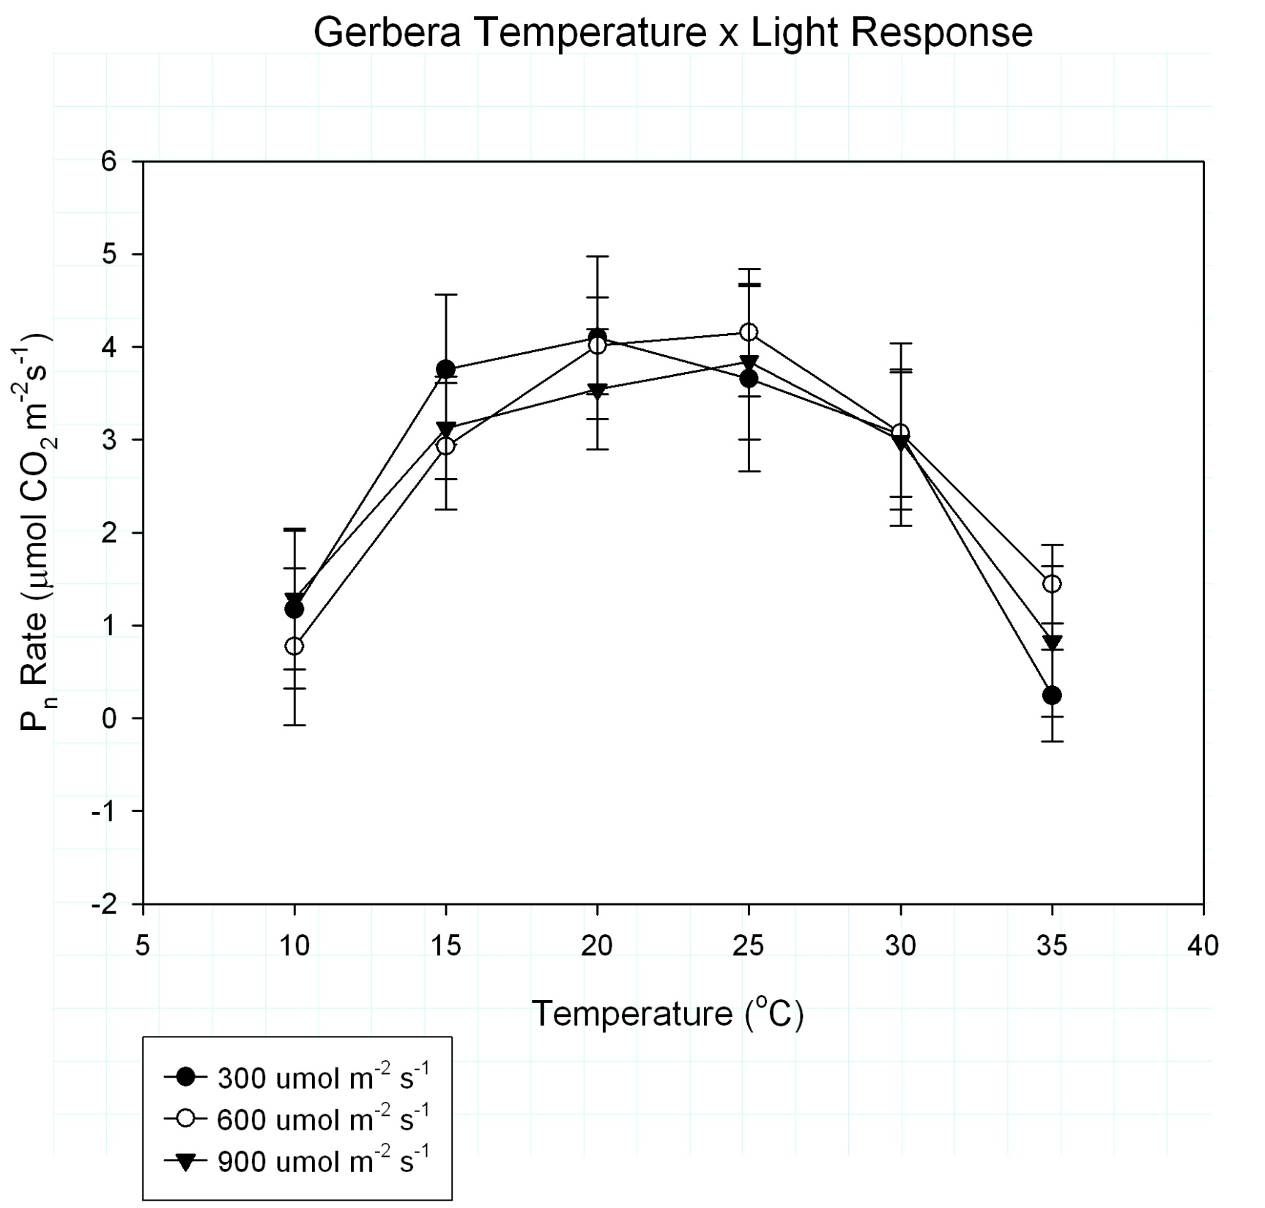

Slide 10
Plant | Delay when average daily temperature is reduced 1oF
Angelonia ‘Angelface White’ | 2.4 days
Blue Salvia ‘Strata’ | 3.1 days
Calibracoa ‘Superbells Pink’ | 1.5 days
Diascia ‘Flying Colors Coral’ | 1.2 days
Gazania ‘Daybreak Red Stripe’ | 1.5 days
Nemesia ‘Sunsatia Peach’ | 0.8 days
Pansy ‘Delta Pure White’ | 1.0 days/1.6 days
Petunia ‘Avalanche Pink’ | 2.5 days
Petunia ‘Purple Wave’ | 3.3 days
Impatiens ‘Super Elfin Lipstick’ | 1.8 days
Snapdragon ‘Liberty Bronze’ | 1.6 days
Viola ‘Sorbet Blackberry Cream’ | 1.1 days

Slide 11
Plants for a high temperature house (68-78ºF) – based on DTF
Angelonia
Blue Salvia
Purple Wave Petunia
Mercardonia
Scaveola
Browallia
Cleome
Canna
Tomato
Coleus
Pentas
Zinnia
Vinca
Melampodium
Gomphrena
Cosmos
Celosia
Pepper
Basil
Many grasses

Slide 12
Plants for a temperature house (63-72ºF) – moderate based on DTF
Calibracoa
Gazania
Impatiens
Snapdragon
Petunia ‘Supertunia Bordeaux’
Verbena ‘Superbena Burgundy’
Cosmos
African Marigold
Ageratum
Some petunias
Portulaca
Red Salvia
Cosmos
Sunflowers

Slide 13
Plants for a low temperature house (55-65ºF) – based on DTF
Argyranthemum
Osteospermum
Pansy
Viola
Diascia
Nemesia
Dahlia
Some lobelia
French marigold
Some petunias
Some snapdragons
Dianthus
Alyssum

Slide 14
Chilling
A number of crops can get severely delayed by even a short cold temperature exposure. What is a cold temperature?
  With vinca it is any temperature below 65oF.
  With celosia it is a temperature below 60oF.
  With basil it is below 50oF
Remember young plants (plugs/liners) are always more sensitive to a cool temperature delay than older plants.

Slide 15
Chilling is a MAJOR issue with vinca!
Always maintain plugs and plants at 68ºF. This is especially important when plants are young.

Slide 16
Take Home . . . .
Only grow warm temperature requiring plants (including vinca) at temperatures above 68ºF.
Excessively high temperatures can slow development and reduce photosynthesis and sizing.

Slide 17
Common Problems in Production
Deep planting
The right temperature
Premature of late flowering
CO₂ deficiency
Stretching and late pruning
pH and EC
PGR mistakes
Bad heaters
Pests and Diseases
What’s new?

Slide 18
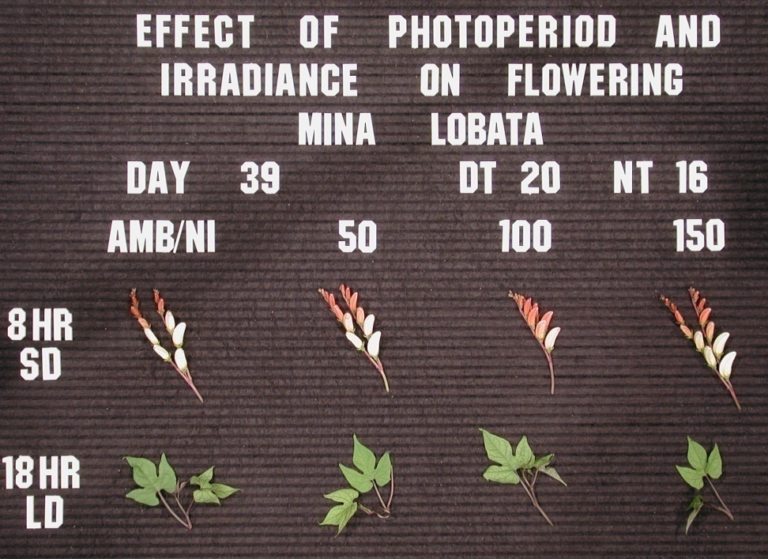
Obligate Short Day Plant
Plants only flower when grown
under short days.

Slide 19
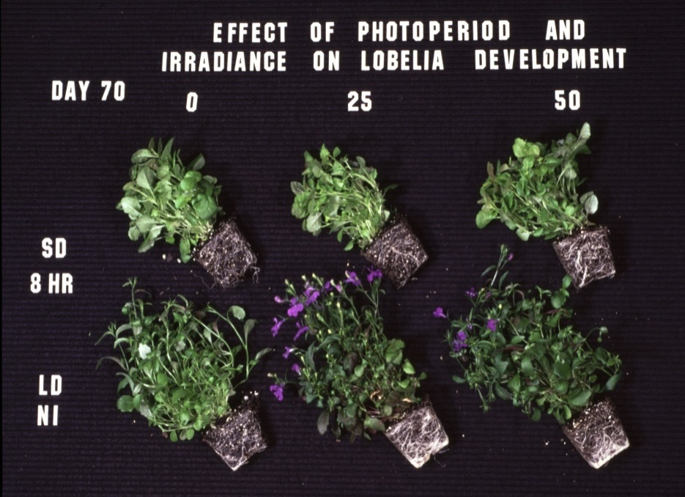
Obligate Long Day Plant
Plants only flower when grown under long day conditions.

Slide 20
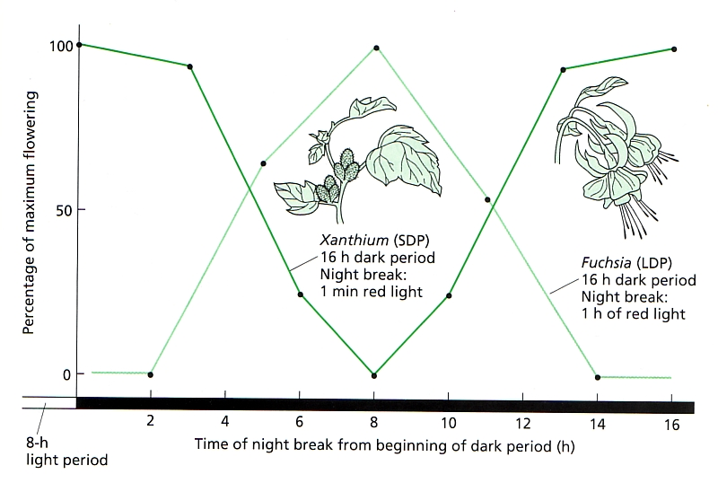

Slide 21
Photoperiodic lighting
Only 10 footcandles (2 umol m⁻² s⁻¹) is generally required.
We interrupt the night from 10pm-2am. Some extend the day to a required length of 2 am.
Use incandescent, fluorescent or HPs for short-day plants, and incandescent, HPS, or new flowering LEDS for long-day plants.
If using LEDs, they must contain far red light to be effective.
If night temperatures are cool (<60ºF), if light intensity of the NI is less than 10 footcandles, or if you use cyclic lighting, the length of the NI may need to be increased to 6 hours.

Slide 22
Take Home message.. .
Prior to March 1, light cosmos, celosia and elegans zinnias with night interruption lighting to delay flowering for 1-3 weeks after planting – then let naturally induce.
Light tuberous begonias until March 21 with night interruption lighting.
Extend daylength on dahlias to 14 hours to maximize flowering and minimize tuber formation.
To have lobelia, Indian summer rudbeckia, fuchsia, snapdragons and dianthus flower early, light with 3-5 weeks of NI lighting prior to March 21.

Slide 23
Common Problems in Production
Deep planting
The right temperature
Premature of late flowering
CO₂ deficiency
Stretching and late pruning
pH and EC
PGR mistakes
Bad heaters
Pests and Diseases
What’s new?

Slide 24

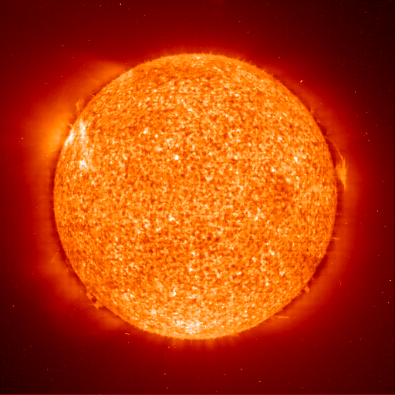
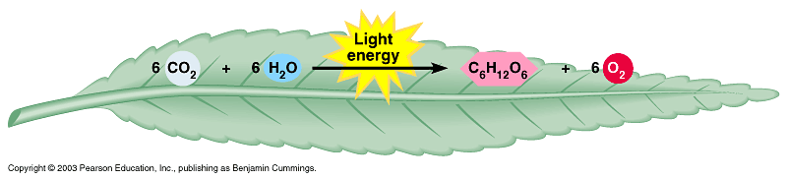
Photosynthesis
Carbon dioxide + water glucose + oxygen
sunlight
absorbed by chlorophyll
6CO₂ + 6H₂O + energy → C₆H₁₂O₆ + 6O₂

Slide 25
Sealing up gaps lowers CO₂
In 1 hour, CO₂ can drop to:
370 in low light
or small plants
340 in medium light
or medium plants
310 in high light
or large plants

Slide 26
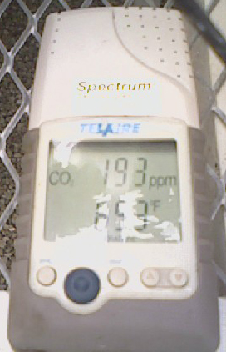
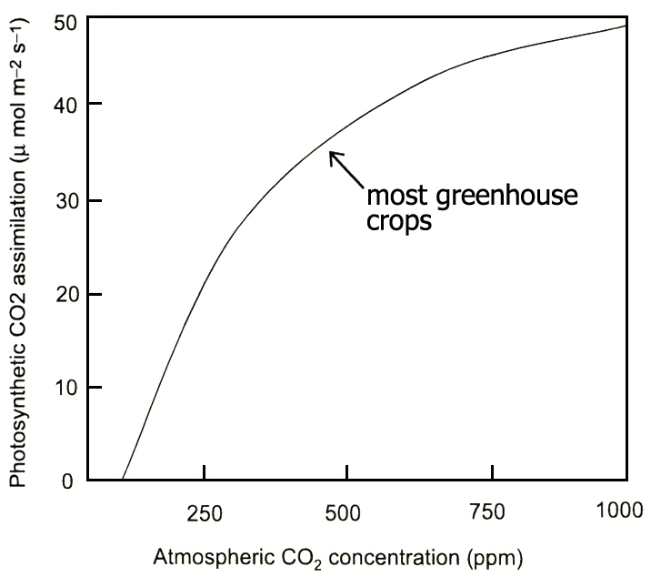
Reduced leakage can lead to lower CO₂

Slide 27
Take Home Message . . .
In a closed greenhouse, low CO₂ levels will decrease sizing and flowering.
During bright, cold days consider periodically venting greenhouses OR purchasing an injection system to raise CO₂ levels to 800 ppm.
CO₂ addition is often more cost efficient than lighting when growth conditions are bright and greenhouses are closed.
Consider open roof greenhouses for future building.

Slide 28
Common Problems in Production
Deep planting
The right temperature
Premature of late flowering
CO₂ deficiency
Stretching and late pruning
pH and EC
PGR mistakes
Bad heaters
Pests and Diseases
What’s new?

Slide 29
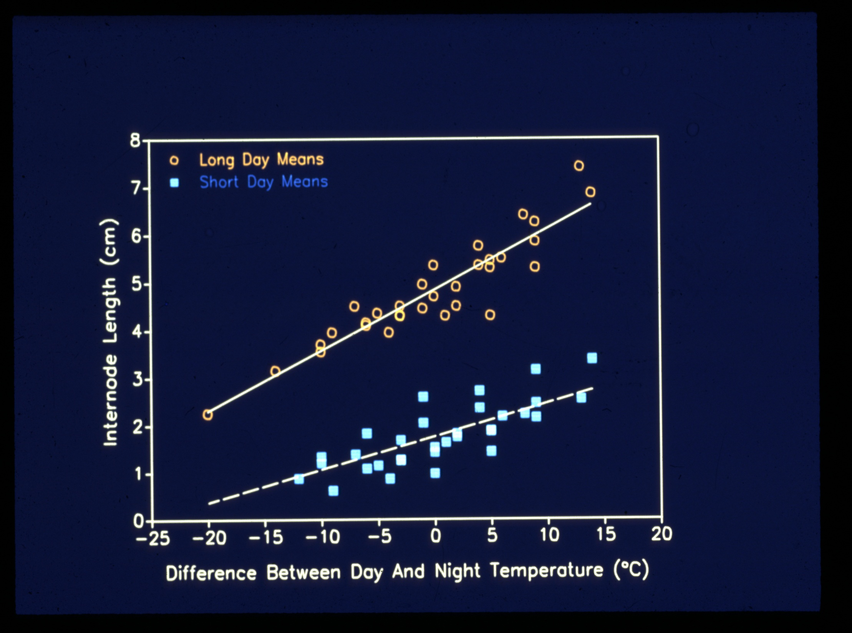

Slide 30
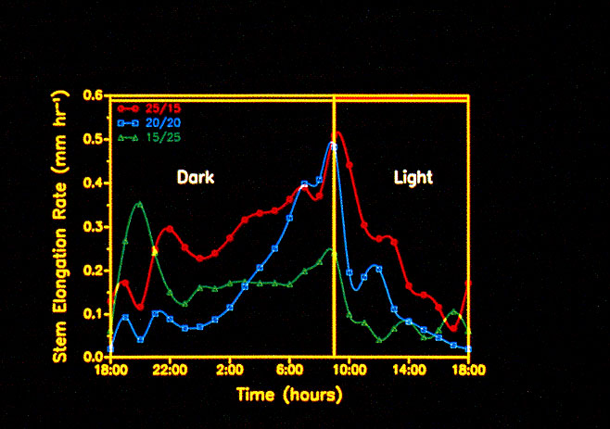
Dropping temperatures the first 3-4 hours of the day by 7-10ºF when most stem elongation is occurring will reduce elongation by about 30%.

Slide 31
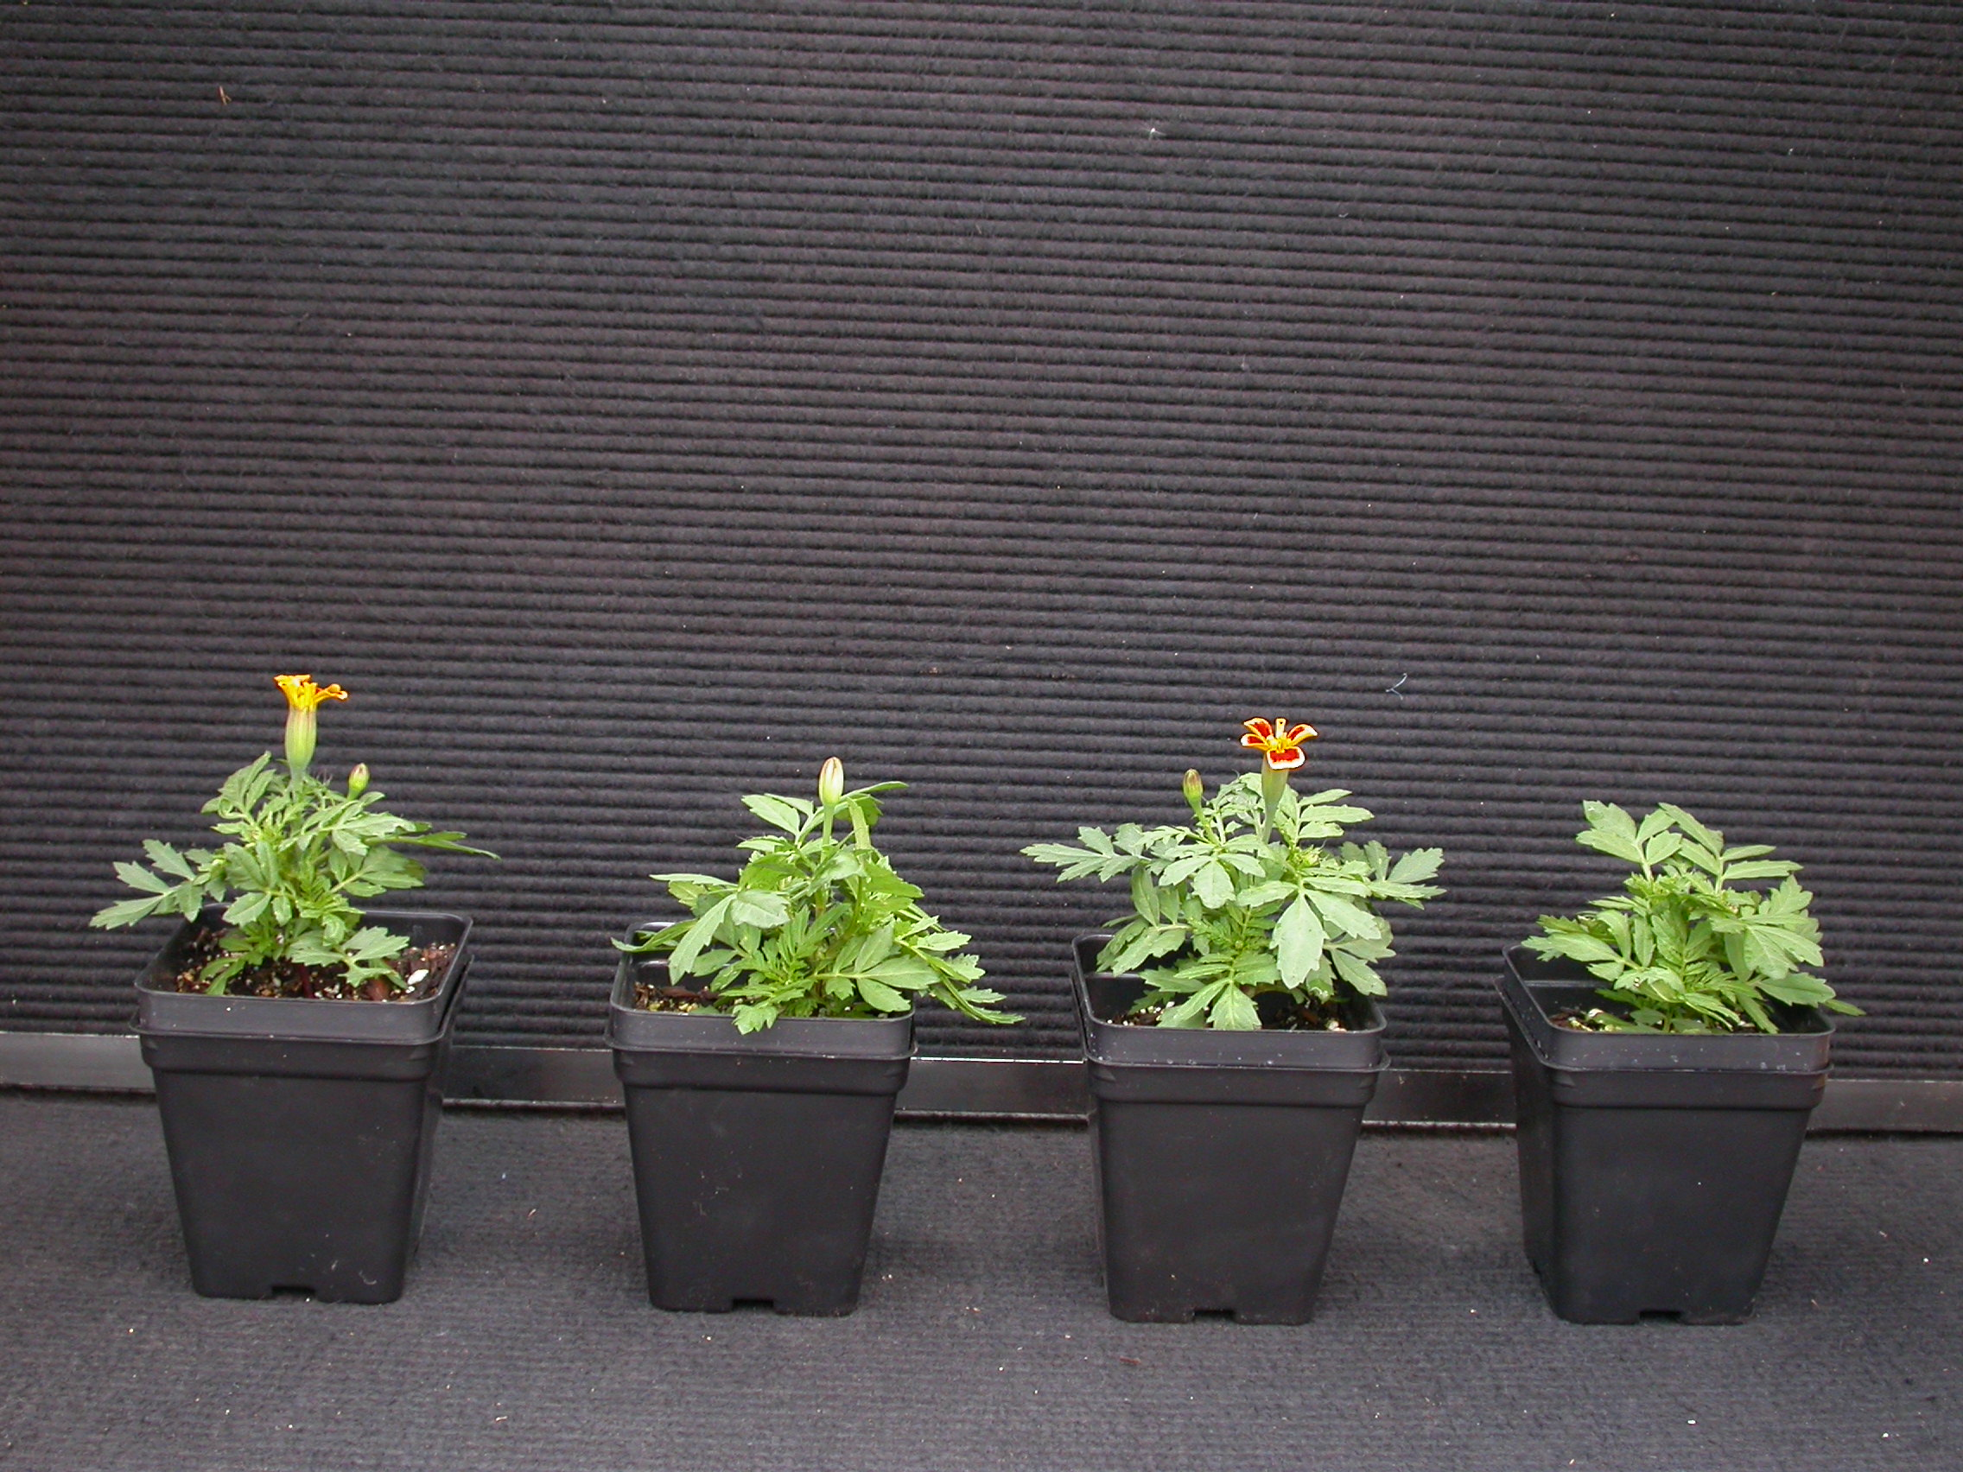

0 ppm
600 ppm
Marigold
Fast-drying
(86 F/ 45% RH)
Slow-drying
(59 F/ 85% RH)

Slide 32
Rewetting increases effect!

Slide 33
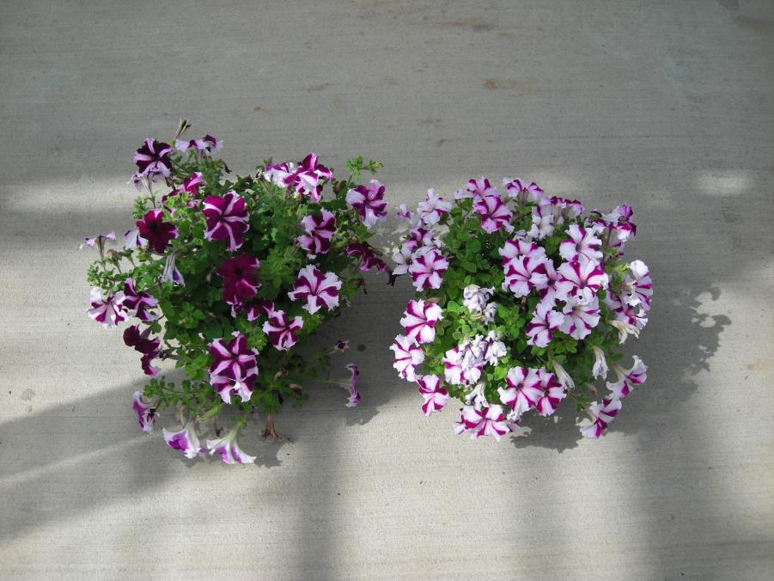
Untreated
B9 + Florel

Slide 34
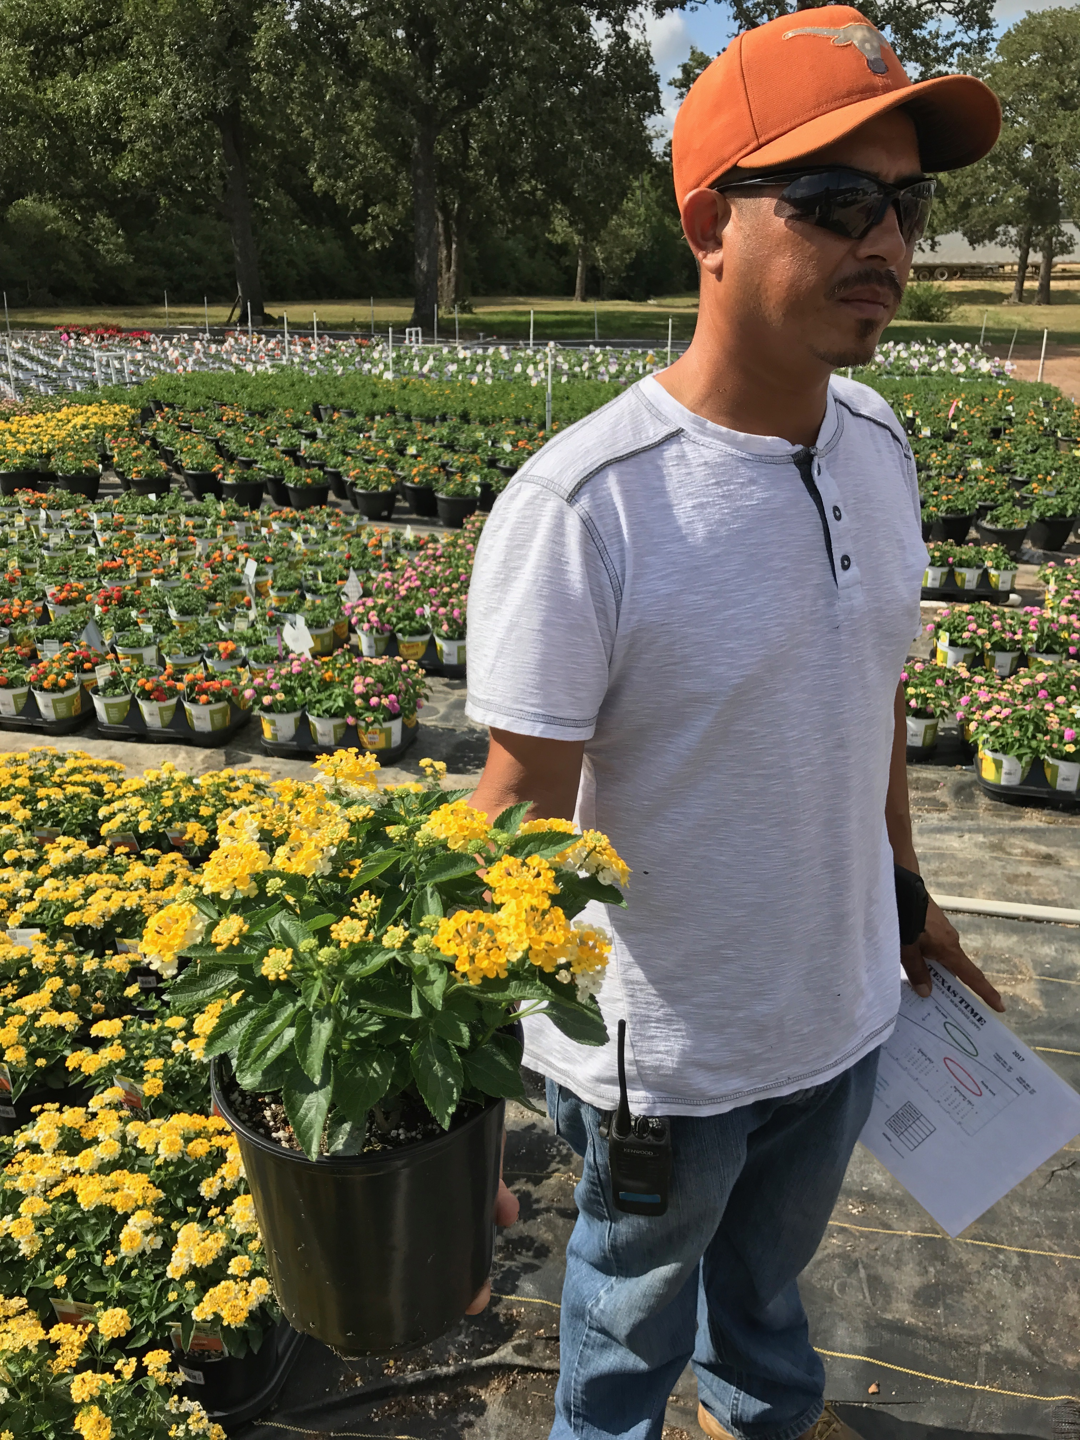
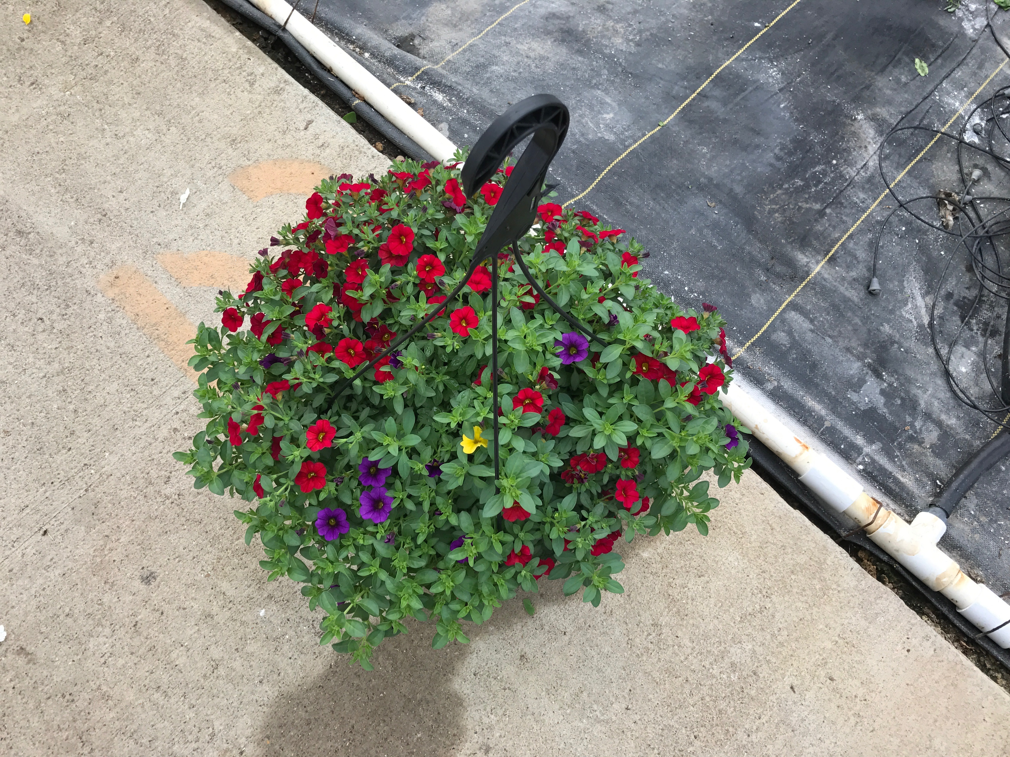
Configure can be added to the production schedule to reduce labor and/or crop timing.
No Florel – Configure x 2 (200 ppm)
Previous: Florel x 2 (500 ppm)
Now: Florel (500 ppm) then Configure (200 ppm) = 2-3 week reduction in crop timing

Slide 35
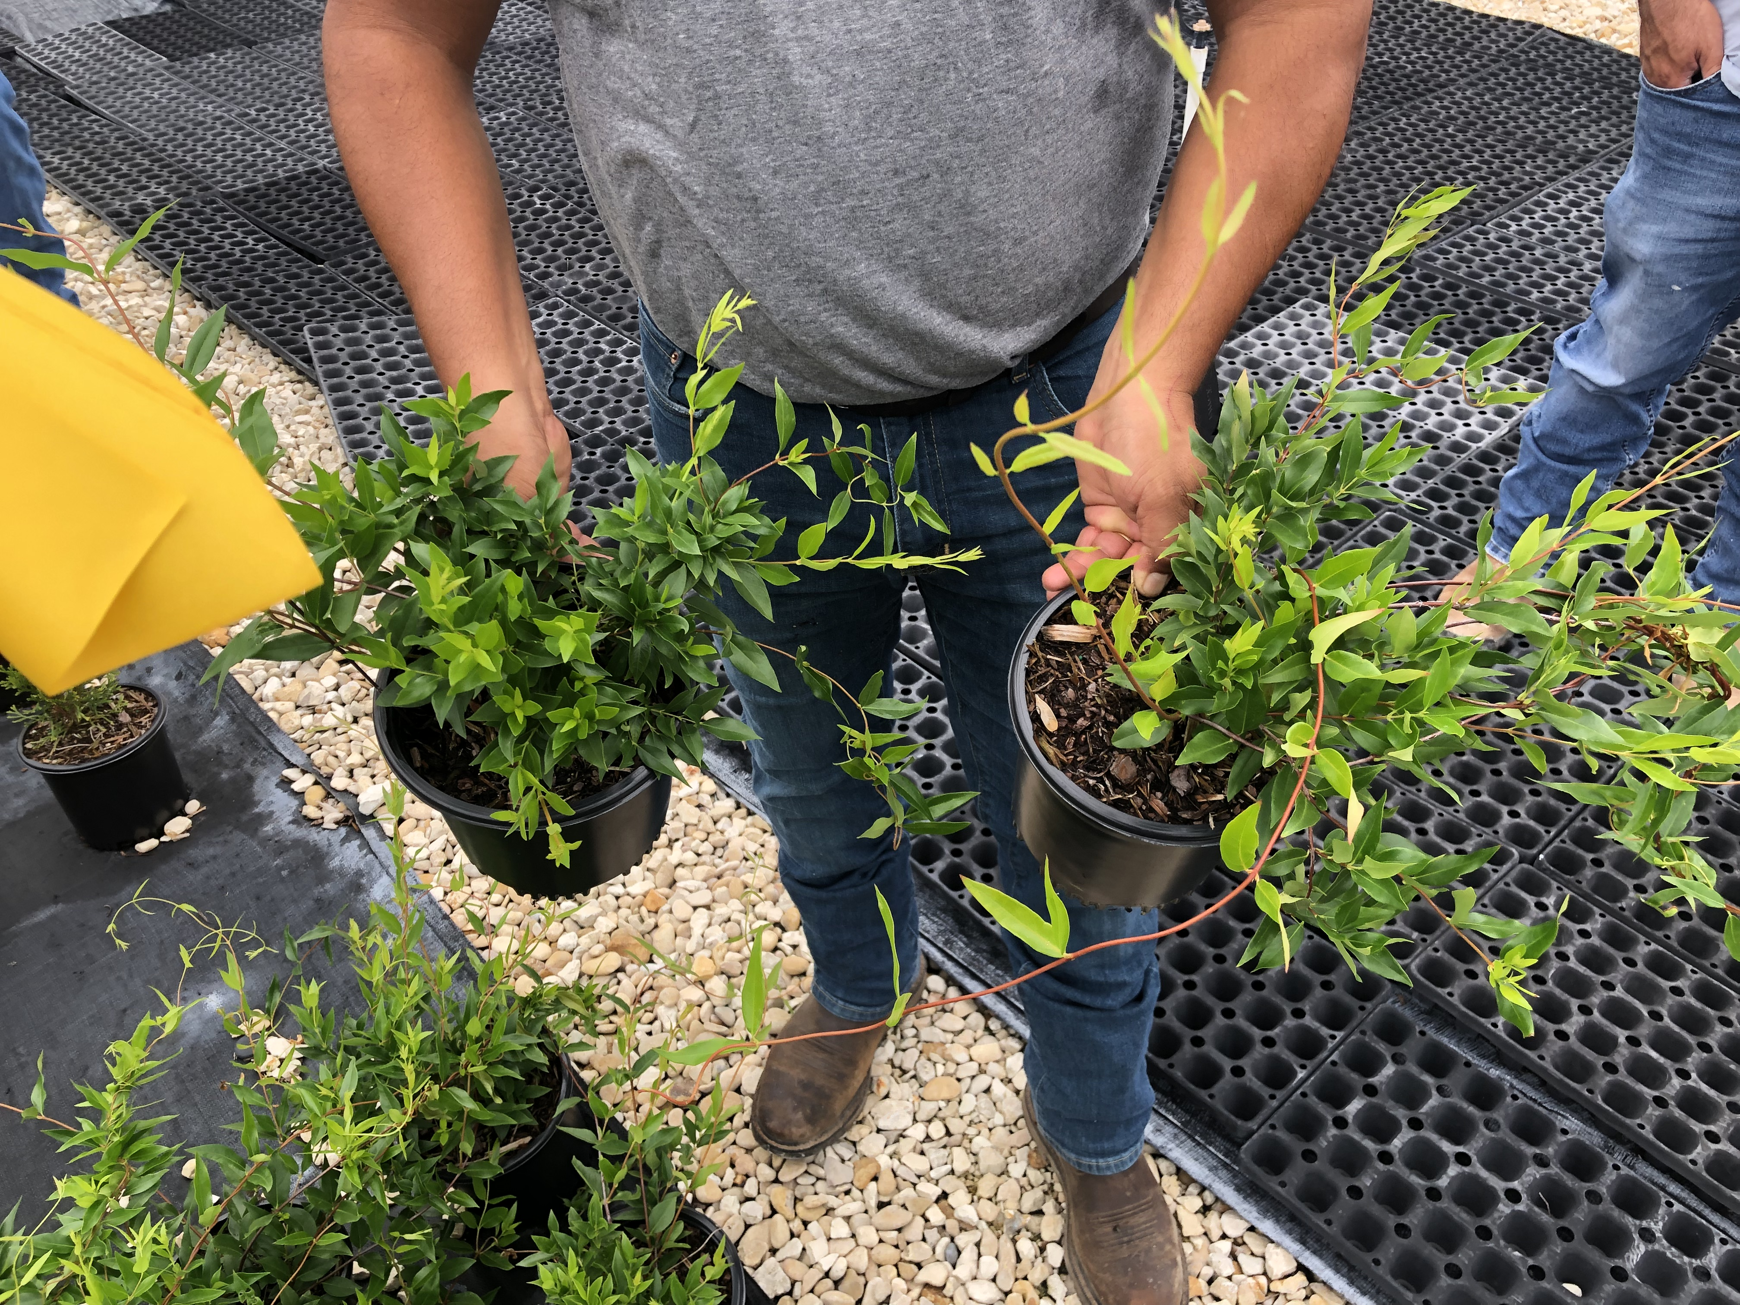

Slide 36
Effect of branching PGRs alone, or in combination on Ficus pumila branching.

Slide 37
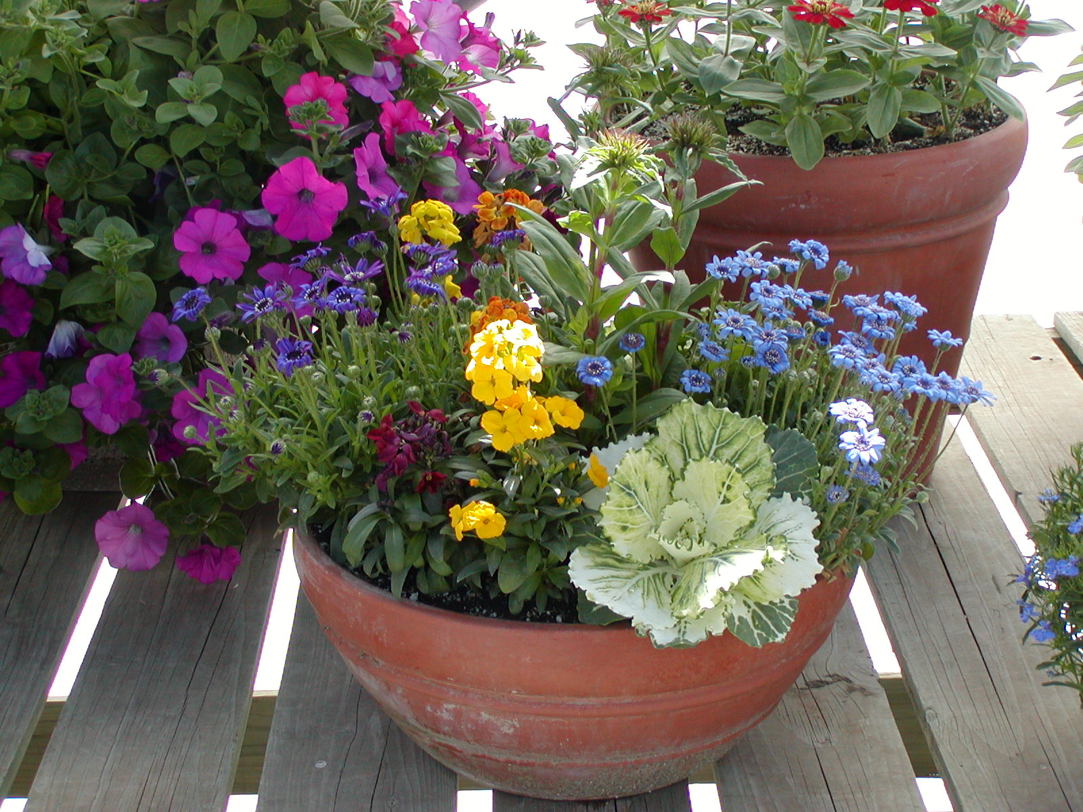

Slide 38
Late Bonzi Drenches - Apply 15 oz per 10” pot
Crop | Bonzi Drench
Seed Impatiens | ½ - 1 ppm
Double impatiens | 1-2 ppm
New Guinea impatiens | ¼ ppm
Vegetative Petunias | 2 - 4 ppm
Geraniums | ½ - 1 ppm
Many new vegetatives | 1 - 2 ppm
Many generic 4” potted | ½ - 1 ppm
Purple Wave Petunia | 4 ppm
Coleus | ¼ - ½ ppm

Slide 39
Take Home Messages . . .
Limit day temperatures increasing to temperatures more than 85ºF.
At the end of the night, let temperatures decrease 10ºF (except on cold sensitive species). Plants should be cold at dawn and for the first 2-3 hours of the day.
Apply PGRs and systemic pesticides and fungicides in the morning if possible.
Consider applying the following tank mixes/PGRs: B-9 + Configure, B-9 + Florel, Configure.

Slide 40
Common Problems in Production
Deep planting
The right temperature
Premature of late flowering
CO₂ deficiency
Stretching and late pruning
pH and EC
PGR mistakes
Bad heaters
Pests and Diseases
What’s new?

Slide 41
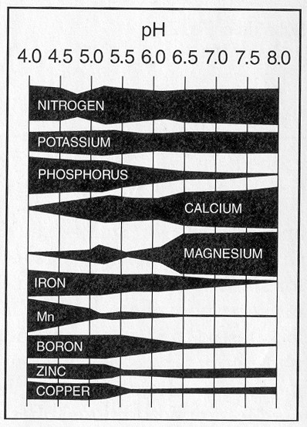
Geraniums and New Guinea impatiens should be grown in media with a pH of 6.2-6.6 because at lower pH levels they take up too much iron and manganese.
In contrast, grow calibrachoa and petunias at pH levels between 5.7 and 6.2 because these crops are poor at taking up iron.

Slide 42
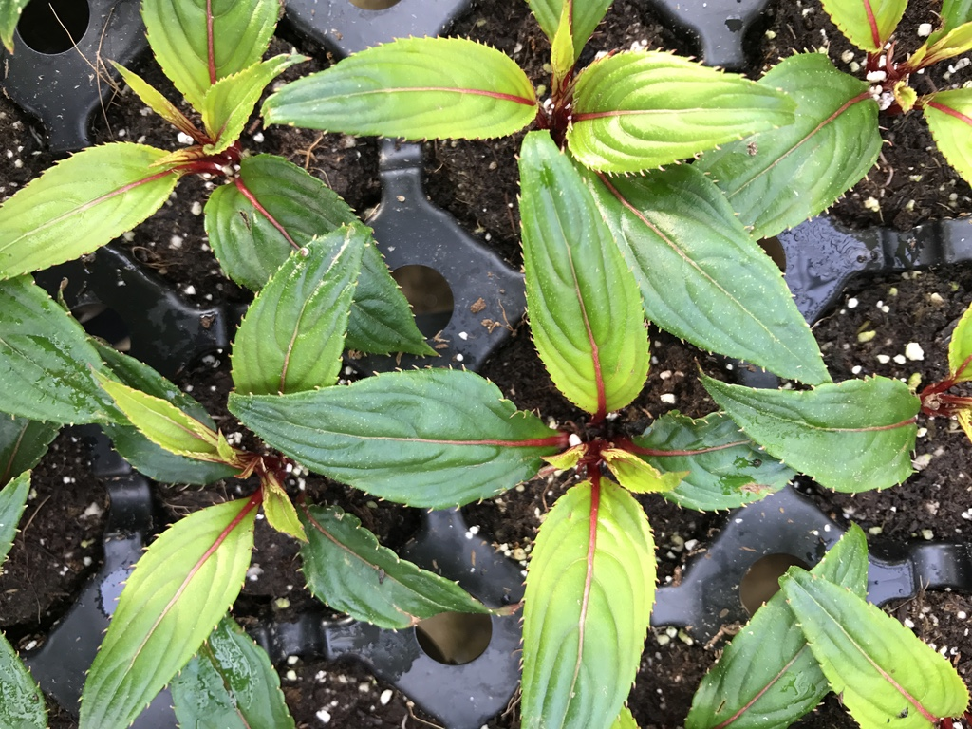

Slide 43
pH Sensitive Crops
Low pH Sensitive
  Geraniums
  New Guinea impatiens
  African marigolds
  Dianthus
  Pansies
  Pentas
High pH Sensitive
  Petunias
  Scaveola
  Osteospermum

Slide 44
Modifying pH
Decreasing pH
  One time applications – 2 oz sulfuric acid/100 gallons of water. Decreases pH approx. 0.5 pH units.
  Apply acidic fertilizers – 20-0-20, 20-10-20, 20-20-20 ,21-7-7
Increasing pH
  Applying liquid lime (Cleary’s Liquid Lime)
  Drenching with potassium bicarbonate (1 lb/100 gallons); warm water.
  Apply basic fertilizers – 15-0-15.

Slide 45
If you have high alkalinity, adjust alkalinity down by adding acid to your water prior to adding fertilizer.
350 meq CaCO₃ (actual) – 120 meq CaCO₃ (desired) = 230 meq CaCO₃ (which needs to be neutralized).
Use sulfuric acid.

Slide 46
EC and Slow release .. . .
The max rate of slow release you should use in a greenhouse is 3 lbs/cubic yard.
Slow release releases most nutrients in the first month and more quickly when temperatures are hot and pots are wet. . . . . Consider liquid feed indoors.
Check your EC. . . .no more than 3.0 with a 2:1 test! If it is high, leach .. . Even though the plant may look hungry!
If you have EC burned roots, leach and drench with fungicide simultaneously.

Slide 47
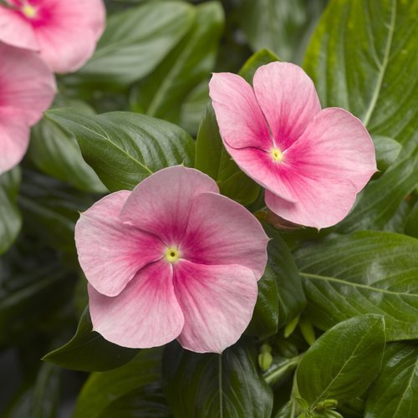
Special note on vinca
Fertilizing vinca after transplanting reduces rooting.
When transplanting vinca plus.. . . Plant into media that includes NO controlled release fertilizer (CRF).
Also, do not feed for the first couple weeks.

Slide 48
Common Problems in Production
Deep planting
The right temperature
Premature of late flowering
CO₂ deficiency
Stretching and late pruning
pH and EC
PGR mistakes
Bad heaters
Pests and Diseases
What’s new?

Slide 49
Excessive growth retardant application
Most common way to overcome this is to apply:
  5-10 ppm ProGib, or
  Facsination, or
    Drenches are more effective than sprays
  Fresco

Slide 50
Common Problems in Production
Deep planting
The right temperature
Premature of late flowering
CO₂ deficiency
Stretching and late pruning
pH and EC
PGR mistakes
Bad heaters
Pests and Diseases
What’s new?

Slide 51
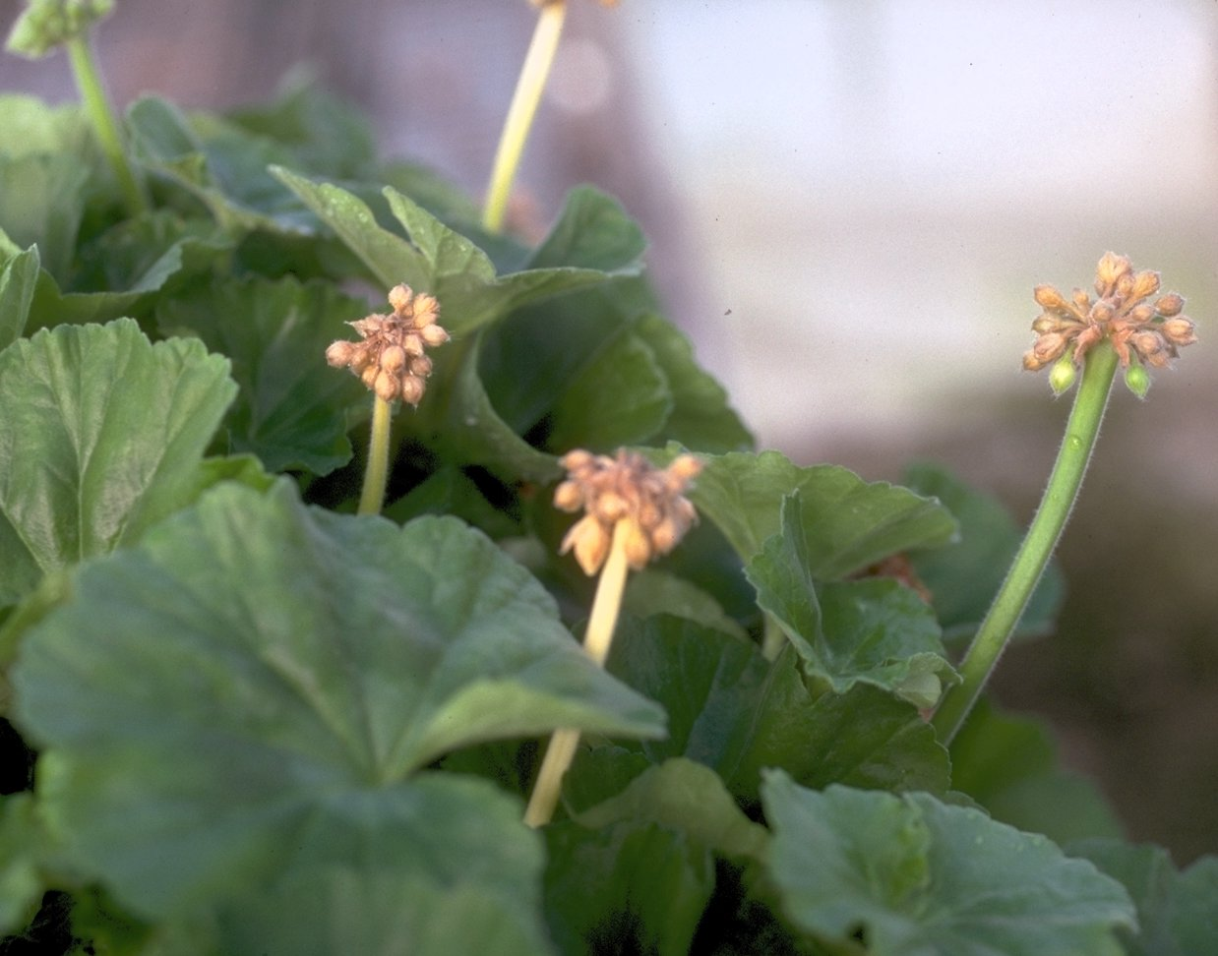

Slide 52
Take Home Message . . .
Check gas/propane heaters for improper burning sometime around October. Either hire a heating repair person to measure heater efficiency in burning or use a CO detector to see if CO levels are high. CO is given off simultaneously with ethylene.
If you have ethylene in a greenhouse, vent periodically.
There is some evidence that an Alesco application can reduce excessive ethylene effects.

Slide 53
Common Problems in Production
Deep planting
The right temperature
Premature of late flowering
CO₂ deficiency
Stretching and late pruning
pH and EC
PGR mistakes
Bad heaters
Pests and Diseases
What’s new?

Slide 54
Pythium and Phytophthora
Easily spread through irrigation water and dust.
Attack from root tips.
Sudden wilting can occur.
More prevalent under cool conditions.
Outer cortex will separate from the root core.
Roots are discolored.
Attach occurs below media surface.

Slide 55
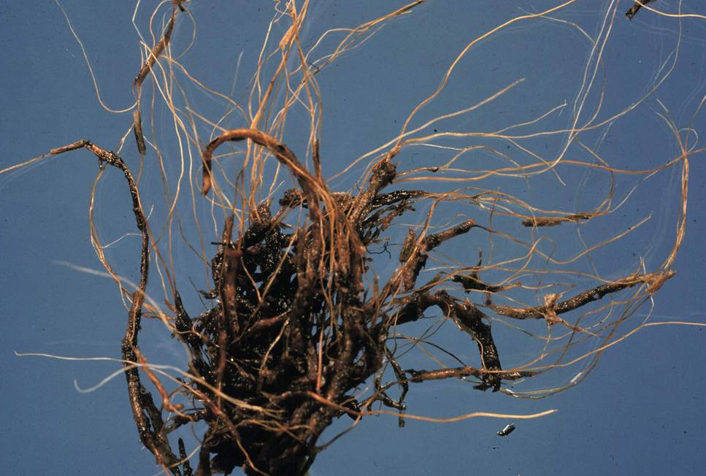

Slide 56
Rhizoctonia
Attacks at the root/media interface. The fungus often grows on the media surface.
Can cause stem cankers (dry appearance) when humidity is high.
Encouraged by warm temperatures.
Plants can suddenly wilt.
Attach occurs at media surface.

Slide 57
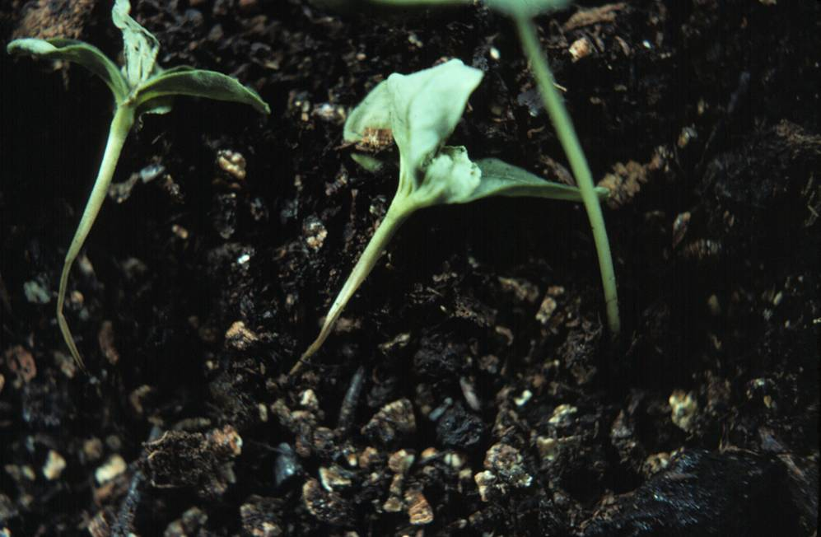

Slide 59
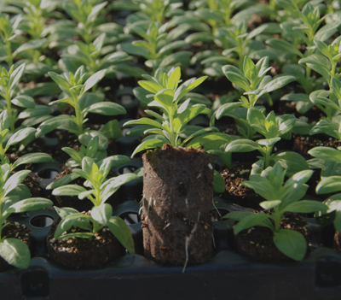
Protective Liner/Plug Drenches
Subdue + Cleary’s 3336 + Safari
Subdue + Terraclor + Safari + Heritage
Heritage + Safari + Bonzi
Heritage + Subdue + Safari
Subdue + Cleary’s 3336 + Cease
Subdue + Cleary’s 3336 + Hexagon

Slide 60
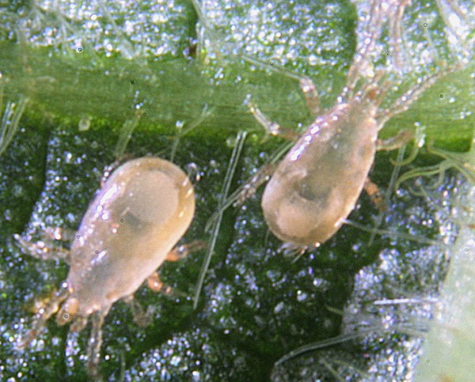

Slide 61
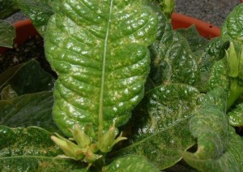
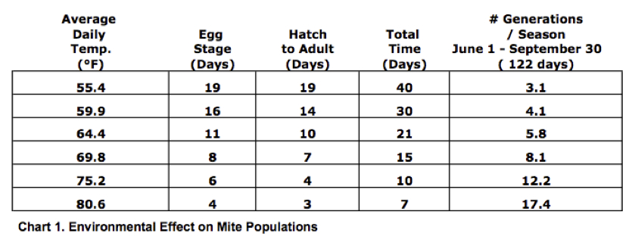
Aside from increasing temperature, mite infestation is promoted by feeding with high nitrogen levels.

Slide 62
Spider Mite Control
Akari, Sanmite * or Shuttle
Avid *
Floramite *
Hexygon DF or Ovation (ovicides)
Pylon EC *
Tetrasan (Mite growth regulator AND ovicide) * - 4 weeks.
Careful with Judo! – Phyto on some crops.
Also careful with oils!

Slide 63
Mite control
Apply 3 miticides with different modes of action (adulticide + ovicide) every 5 days for 15 days. Repeat if not effective.
Focus on coverage!
Apply miticide liner treatments in the future.

Slide 64
Sprays of 1,000-2,000 ppm CaCl₂ (road salt) can decrease foliar diseases.
This converts to 1-2 grams CaCl2 per liter of water (3.785 liters/gallon).

Slide 65
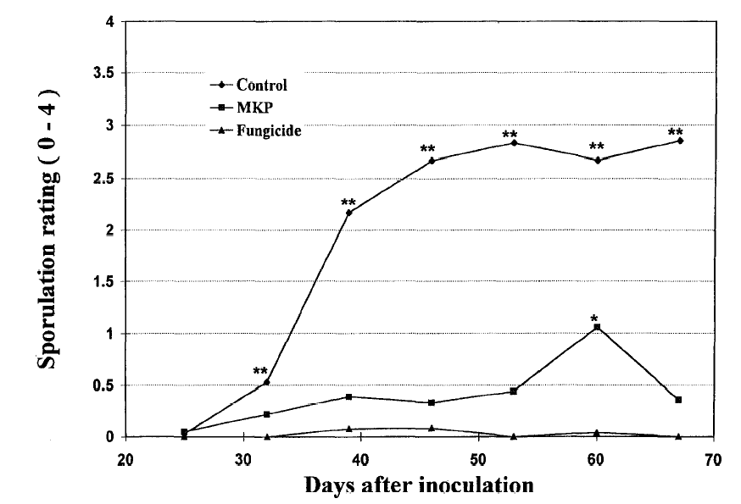

Weekly treatment with:
water
Powdery Mildew in pepper
1% KH₂PO₄ (1.3 oz/gal)
Fungicide
Reuveni et al., 1998
Notes:
Powdery mildew of pepper. Plants treated weekly with monopotassium phosphate (1 ml/leaf). The effects are systemic too: spraying just the lower leaves reduced disease on the upper leaves.
Triton X-100 included in all sprays.

Slide 66
Enhancers
Surfactants. . . . . .
Horticultural oils
Captiva (especially for thrips)
Regalia PTO, Fosphite, Alude, Thiamine (vitamin B1) - Enhance plant defenses
SAR Combos – Essential Organic 1-0-1; SITKO SA 0-7-17
Sil-Guard (0-2-5) – potassium silicate (disease and stress resistance; careful with begonia, geranium, pansy, petunia and tomato)
Methyl Jasmonate (Jasmine oil)
Media additions (Companion, Cease, Triathlon BA, Rootshield; Probiotic, Biotik

Slide 67
Commercial Compounds that Increase Efficacy of Compounds OR Increase Plant resistance to Pests/Diseases

Slide 68
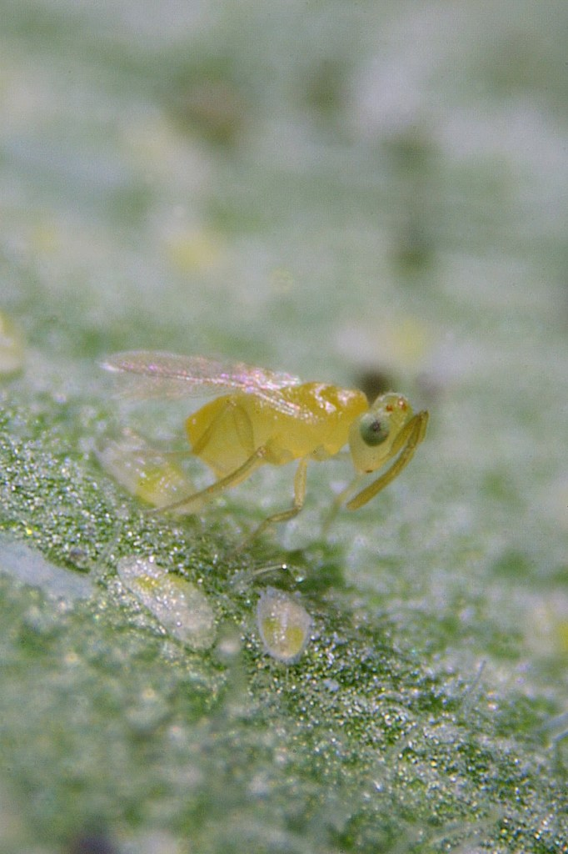
Using other living organisms to is a very effective way to:
- effectively combat pests and diseases
- reduce pesticide and labor costs
- reduce labor issues associated with trying to work around REIs

Slide 69
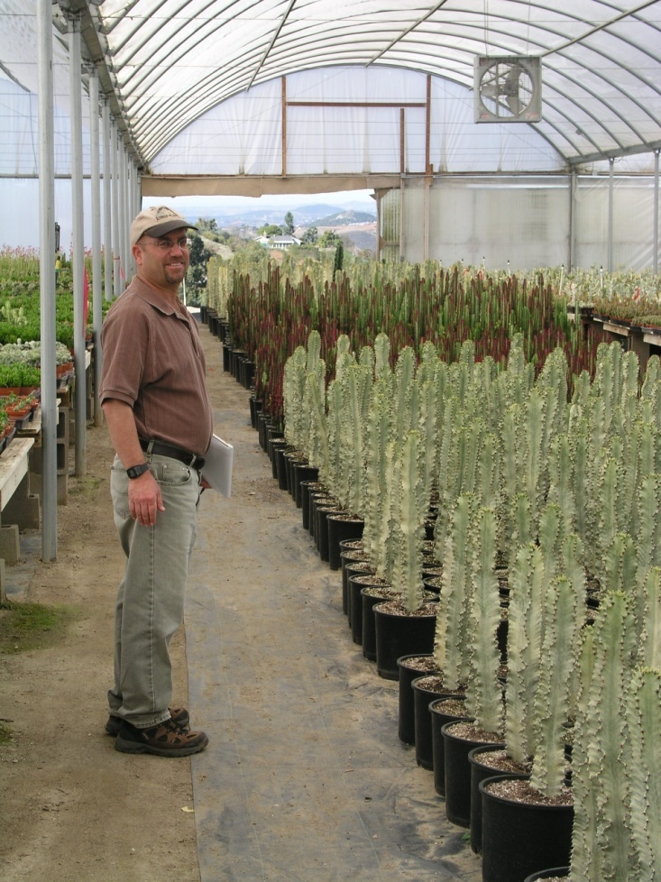
University of Maryland Partners
MNLGA
Maryland Agriculture Experiment Station
Floriculture and Nursery Research Initiative (USDA-ARS) & SAF (AFE)
Gloeckner Foundation
Horticulture Research Institute
Grower Partners:
  Altman Plants, Inc.
  Rocket Farms, Inc.
  Smith Greenhouses, Inc.
  Green Circle Growers, Inc
  Wagner’s Greenhouse
  Go Green Agriculture
  Plainview Greenhouses
  Pleasant View Gardens
  Catoctin Mountain Growers

Slide 70
www.plantgrower.org entire presentation can be found here under ‘Recent Presentations’ button jerwin@umd.edu

